Slide 1
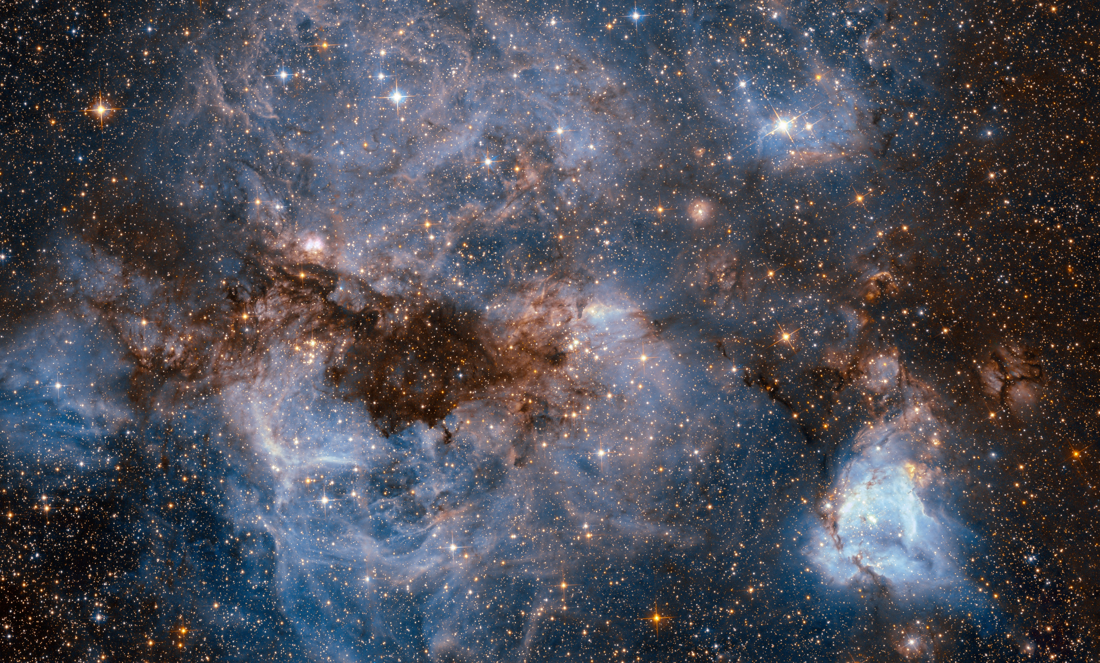
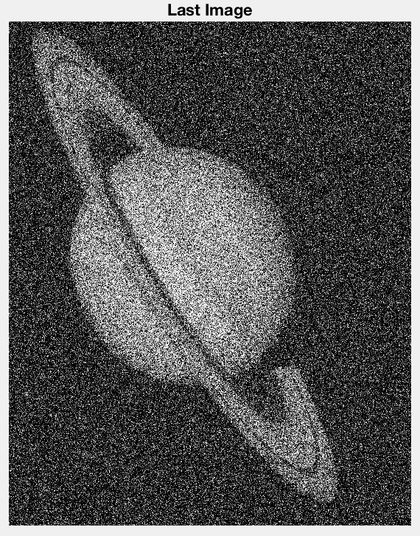

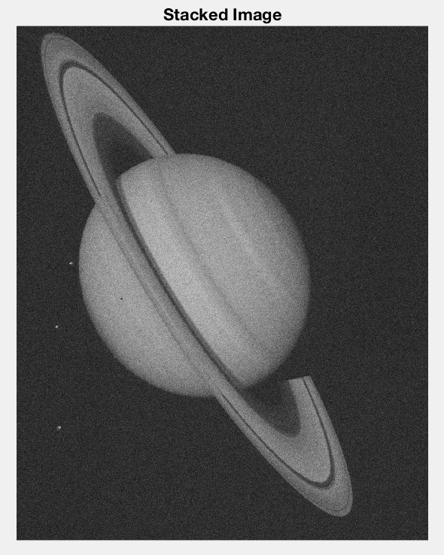
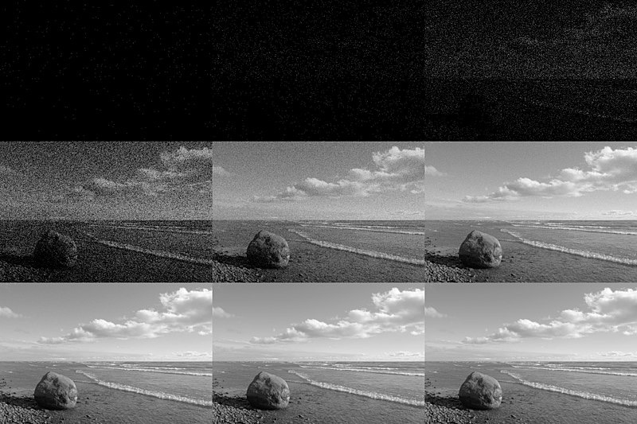
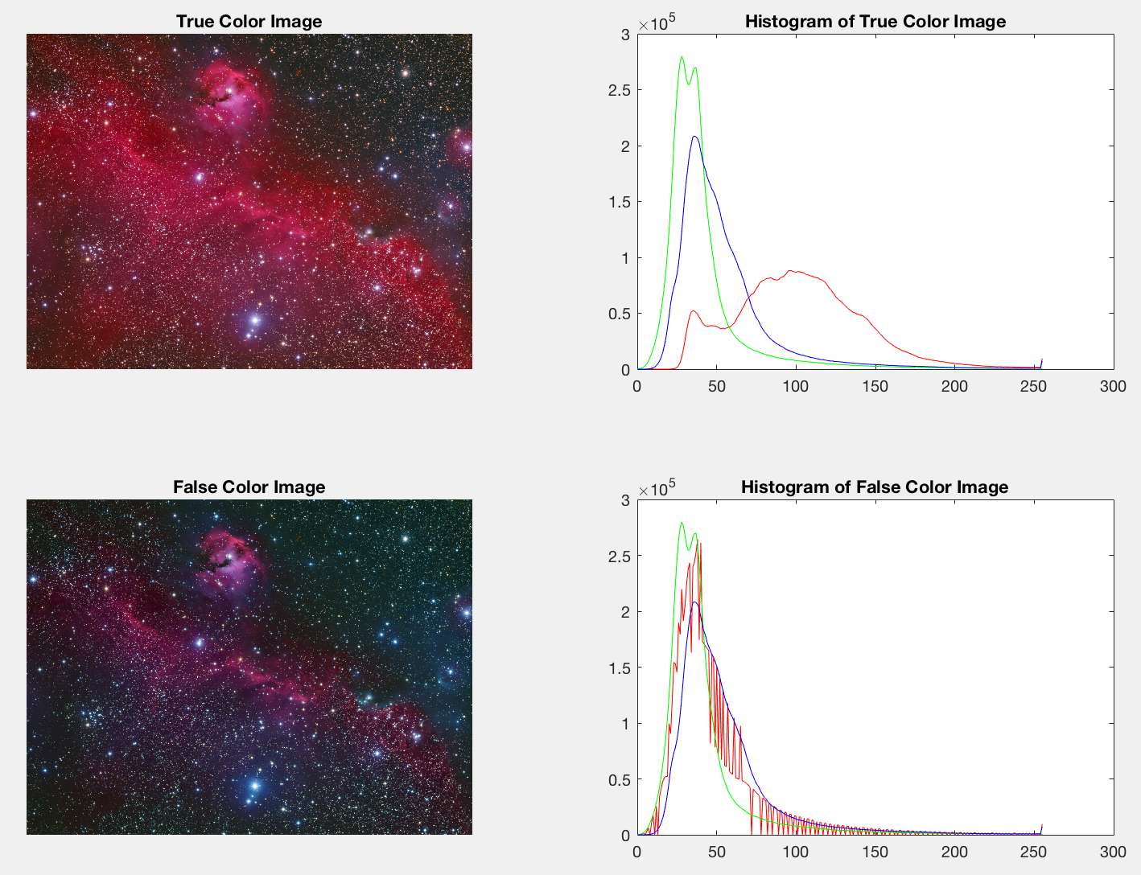
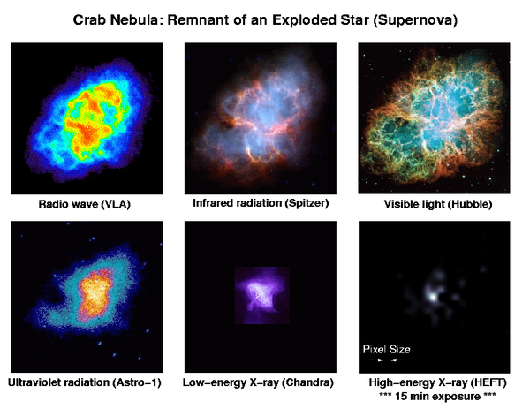
Stacking the Stars
Authors- Matthew Rogers, Sarah Melvin, Marcus Carson
Dr. Meenalosini Vimal Cruz
Astronomical Photography
There are many difficulties that arise when photographing stars and other space objects. Poisson noise is one of the largest factors.
Objective
To explore and implement image processing techniques in astronomical photography.
Image Stacking
This process involves summing the values of multiple images, and then averaging the summed values. It is effective at reducing noise with increased image count.
Pros:
Allows an average camera to produce high quality astrophotography.
The sharpest values will be isolated.
Cons:
Multiple long exposures of an object can be difficult to acquire.
Poisson Noise
When dealing with distant objects, imaging becomes limited by photon acquisition. Total number of photons from a source varies according to a normal distribution. Normal lighting conditions have a minuscule variation. However in Astronomy the smallest shift in the number of photons has huge impact on the brightness of an object. An effective way to counter this noise is with ‘Image Stacking’.
50 images with artificial gaussian noise
Analyzing Astrophotography
A popular method of analyzing these images is with ‘False Color Imaging’. This method allows astronomers to pinpoint specific information and display it easily. It also allows the visual representation of spectrums normally invisible to the human eye.
Histogram Manipulation
In this image the amount of hydrogen in the image which emits a red color, masking some of the other information. If we suppress the red information it reveals the other wavelengths.
Images provided by Connor Matherne
Classification
For images that target a spectrum that can not be seen, we can assign colors to gray values.
Conclusion
Image stacking and false color filtering are both common processes for astrophotography. Image stacking allows cameras with slower sensors to produce high quality astronomical images. False coloring allows us to see structures and values that are not seen with the human eye. Both of these processes give better quality and understanding to astrophotography.
Acknowledgements: We would like to thank Dr. Meenalosini Vimal Cruz for teaching us about image processing and MATLAB.

